Slide 1
The Community for Schools in Europe and Neighbouring Partner Countries
Αn action for schools funded by the European Commission under the Erasmus+ programme.

Slide 2
tOPICS
What is eTwinning (eT)
Benefits of eTwinning
How can we use eTwinning in School Exchange Partnerships (KA229)?
Basic steps for getting involved in eT

Slide 3
eTwinning
Is an exciting learning community for school staff in Europe that offers teachers the opportunity to communicate, collaborate, develop projects, share and be part of an educational network.
Access through a digital platform that is available in 29 languages
36 European countries and 8 neighbouring countries participating

Slide 4
eTwinning – Data as of October 2018
Europe
Μore than 609,000 teachers working in more than 198,000 schools
80,000 projects run, involving more than 2.000,000 students across the continent

Slide 5
Why should you use eTwinning?
It offers a safe, flexible and user friendly platform
It promotes school collaboration in Europe through the use of Information and Communication Technologies (ICT) by providing support, tools and services for schools
It offers opportunities for free and continuing Professional Development for educators (onsite and online seminars, learning events and peer learning)

Slide 6

Benefits of eTwinning
Free teaching material
Improve teaching methods
Enhance skills, competencies and pedagogic approaches
Exchange of good practises
Teaching in a more creative and pleasant way
Strengthens teacher – students bonds
Full curriculum integration in weakly schedules
No extra work load, but helps in daily teaching
Option to choose a project which is based on the school curriculum and syllabi
Classrooms without walls
Transcend the limits of a classroom
Make connections with teachers of other schools/other countries
Keep an update on other countries’ educational systems

Slide 7

Professional Development
Learning Opportunities abroad
Contact Seminars eT
Professional Development Workshops
Learning Events
Online Seminars
Future Classroom Workshops
eTwinning seminars
Professional Development Workshops
Contact Seminars
Online Learning Opportunities
Online Seminars
Learning Events
Regional Learning Opportunities
Annual Conference
Regional Workshops
Webinars

Slide 8

How students can benefit from eTwinning
Creative and pleasant learning environment
Team work
Their work is recognized
Enhance their self-esteem
Create strong friendships
Multiculturalism
Develop their skills and talents

Slide 9




Recognition for teachers
eTwinning Quality Labels are granted to teachers with excellent eTwinning projects. They indicate that the project has reached a certain national and European standard.
National Quality Labels
European Quality Labels
European Prizes
eTwinning School Label

Slide 10

eTwinning School Label
Recognition of the eTwinning work done at school level
eTwinning recognises and appraises the involvement, commitment, dedication not only of scattered eTwinners, but of teams of teachers and school leaders within the same school
Not a competition, but rather a progression from one level to the next
eTwinning Schools will be prioritized in KA229 applications since 2019 Call

Slide 11
eTwinning School Label
Why apply to receive the eTwinning School Label?
Strengthens your school’s profile. Offers high visibility at European and National Level
Officially recognised as examples of good practice in the area of:
  Innovative and creative approaches to pedagogy
  Promoting continuous professional development of staff
  Promoting collaborative learning practices with staff and students
  Digital practice
  eSafety practice
Awarded school staff and principals are invited in dedicated professional development programmes
Be part of a European network of eTwinning leading schools to inspire the future development of eTwinning

Slide 12
eTwinning School Label- criteria
The process for obtaining the eTwinning School Label has two stages.
Stage one
Is an automatic check of the following three points:
The school has been registered on eTwinning for more than two years
There are at least two active eTwinning teachers linked to the school at the time of the application
There is a European eTwinning project with a National Quality Label (within the last two years from application date)
If a school fulfils these requirements, all registered eTwinners in the school will receive an email invitation to fill in a self-assessment application form available on eTwinning Live.
Stage two
Involves completion – by any eTwinner in the school - of the self-assessment application form mentioned above, covering the following six Criteria (https://bit.ly/2LDK6Hs)

Slide 13
ΚΑ229 & eTwinning

Slide 14

eTwinning & School Exchange Partnerships (KA229)
The most appropriate tool to find partners (eT Live)
Useful tools for the implementation of the project and communication with your partner schools (Twinspace)

Slide 15
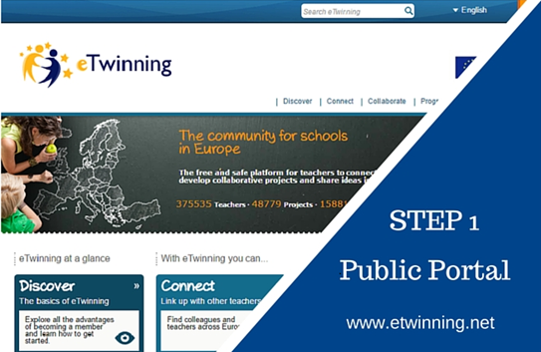
Steps
Contact your partners and agree on the way you are going to use eTwinning
Register all involved teachers on www.etwinning.net

Slide 16
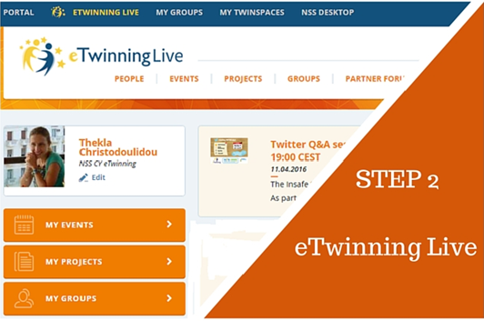
Steps
Spend some time on your personal profile (add a description, name and a profile picture)
Search your partners and add them to your contacts.
Submit your project online for approval

Slide 17
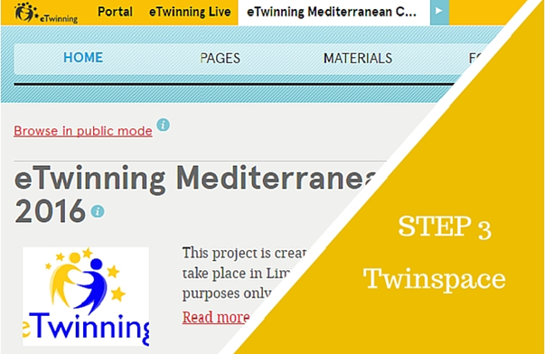
Steps
Make an effective use of the tools of Twinspace
Space where the project is implemented
Space where teachers and students work collaboratively with their partners.
Space to disseminate your project’s results

Slide 18

eTwinning Ambassadors
Visits in schools
Regional eTwinning Workshops
Organize online seminars/groups

Slide 19




National Support Service (CYPRUS NSS)
Foundation for the Management of EU
Lifelong Learning Programmes
Thekla Christodoulidou
tchristodoulidou@llp.org.cy
Noni Hadjicharou
nhadjicharou@llp.org.cy
Polina Stavrou
pstavrou@llp.org.cy
www.etwinning.org.cy
eTwinning Cyprus

Slide 20


Thank you for your attention!

