Slide 1
eTwinning Live

Slide 2
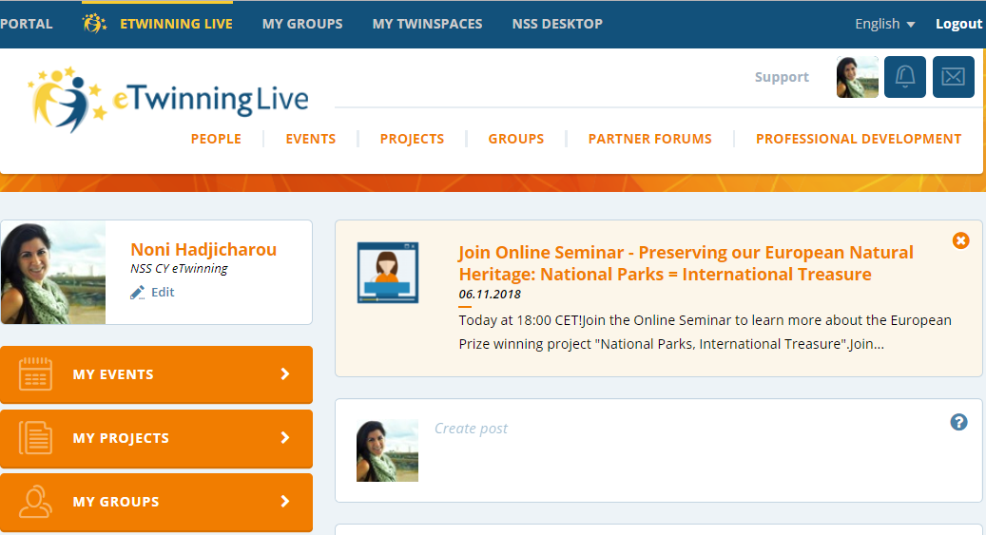
eTwinning Live
…Where teachers experience eTwinning community to its full potential

Slide 3
eTwinning Live
People
See and edit your profile
Find people and schools in eTwinning by typing in a keyword, name, place, etc. in the search box
See your contacts list
Check your feed, including news from the National Support Service and the Central Support Service
Like and comment on the posts or activity of the people you know

Slide 4
eTwinning Live
Events
Create an event
See your events
Check the events calendar per day, week or month
Search events by typing a keyword, name, place, etc. in the search box

Slide 5
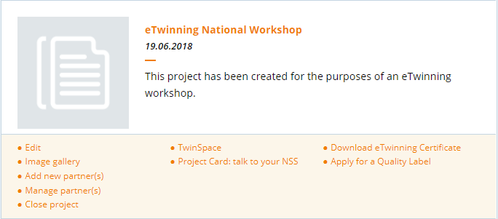
eTwinning Live
Projects
See your active projects: at the bottom of each project you will find different options for actions you can perform within your project, such as edit, add new partners, manage partners, download eTwinning certificate, quality labels, close project, etc.
Access eTwinning project kits
Create a new project
Search projects by typing in a keyword, name, place, etc.

Slide 6
eTwinning Live
Groups
See the groups you are a member of
Search groups by typing in a keyword, name, place, etc. in the search box
Create a new group
View FAQ related to groups: how to join them, featured groups, how to run a group, etc.

Slide 7
eTwinning Live
Partner Forums
Look for partners for Erasmus+ School Exchange Partnerships and/or eTwinning projects
Find posts from teachers who are looking for project partners by typing in a keyword, name, place, etc. in the search box
Create your own post/call for partners
Professional Development
Check the online professional development opportunities eTwinning offers at European level
Join online learning events and seminars

Slide 8
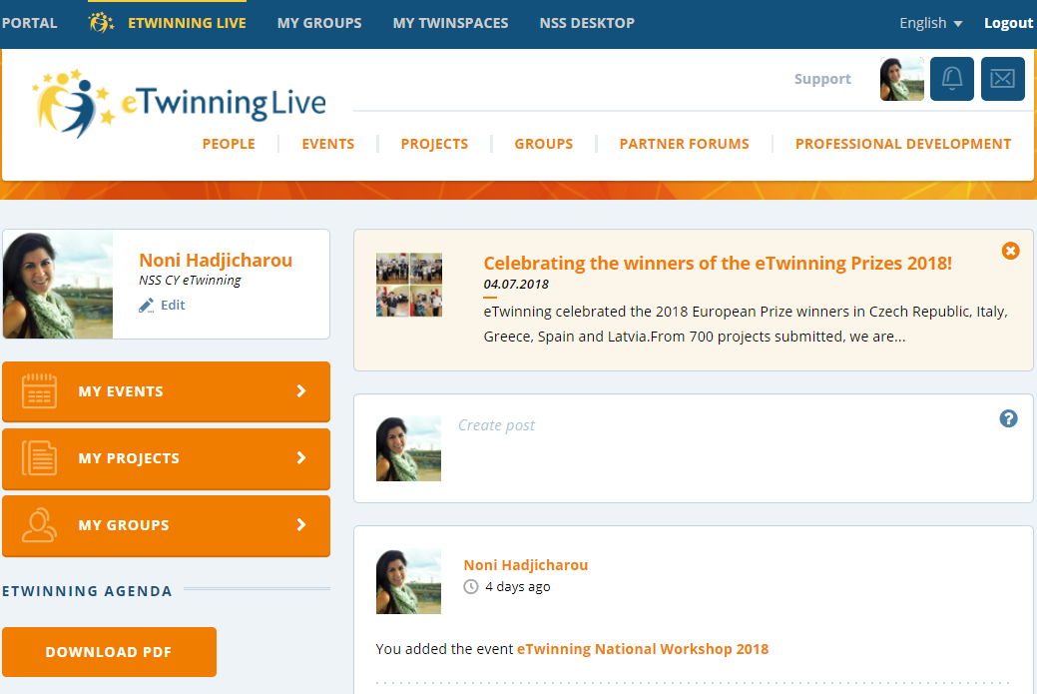
Adding a contact
Click on people

Slide 9
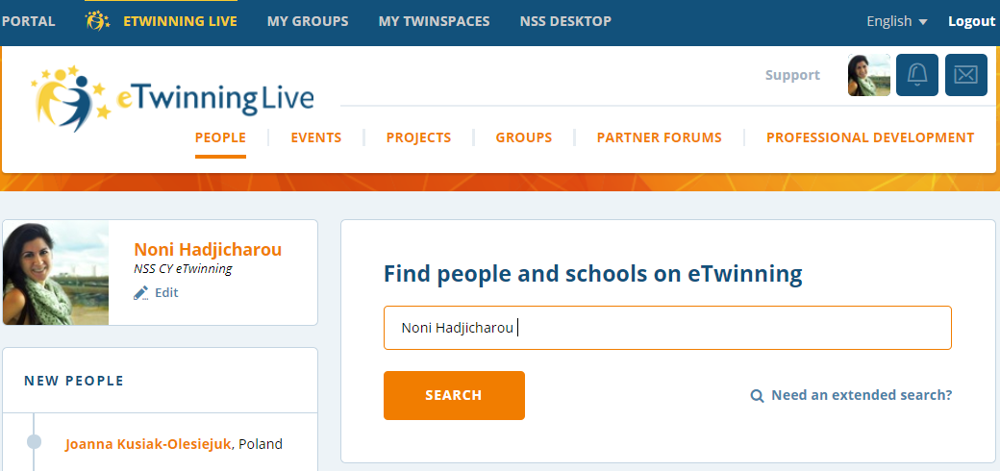
Adding a contact
Type the name of the person you want to add in your contacts
Click on SEARCH

Slide 10
Adding a contact
Click on the following button

Slide 11
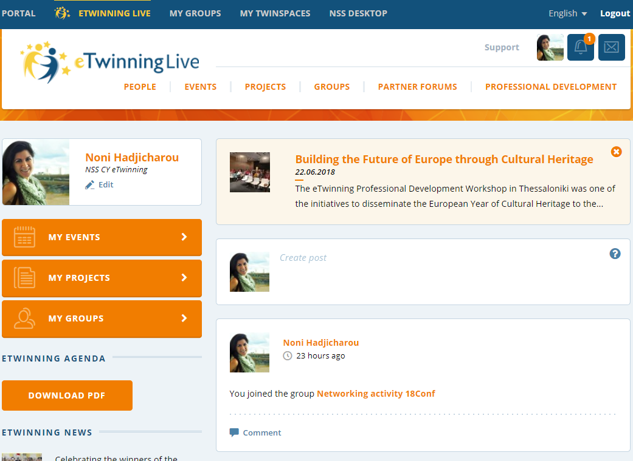
Accepting an invitation
When someone adds you in eTwinning Live, you will get a notification and you need to accept the invitation.

Slide 12
Register a project
Register your project to gain access to a secure online workplace called the Twinspace, where you can then invite your students to join and collaborate with their European peers.

Slide 13
Register a project
Before Registration
Identify a partner teacher/school to work with
Make sure your partner is in your eTwinning Contacts List
Agree what type of project you are going to work on together
Plan your project with your partner(s); agree on: title, short description of the project, aims, tools to be used, work process, and expected results. You will need these when you register your project

Slide 14
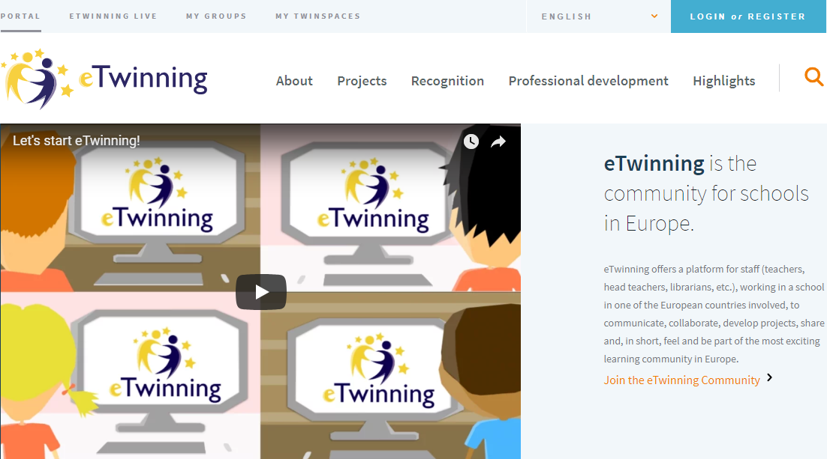
Register a project
Registration
Log in on www.etwinning.net
Go to eTwinning Live

Slide 15
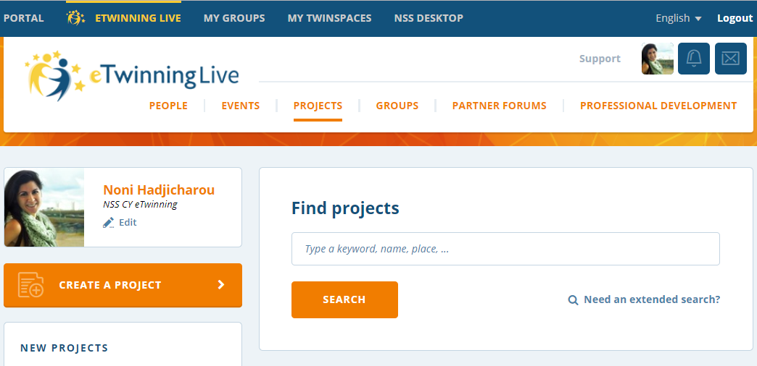
Register a project
Click on Projects
Click on Create a Project
15

Slide 16
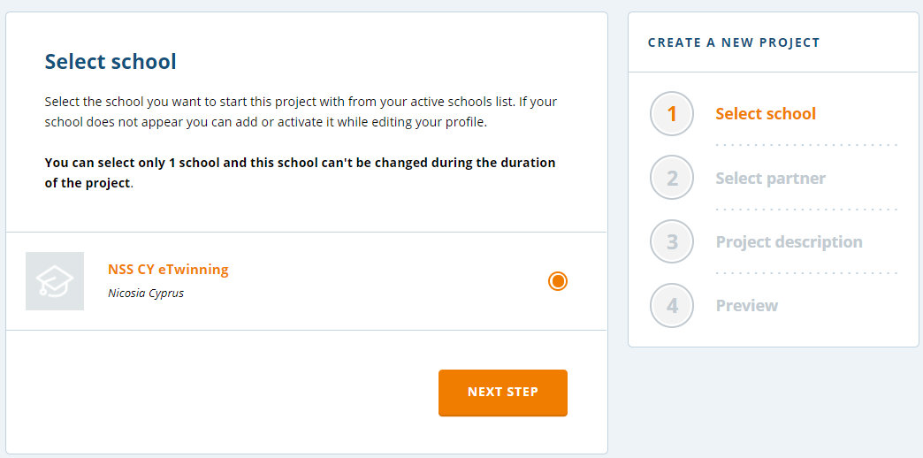
Register a project
Follow the steps shown
Preview your project and then click on the Submit button
Congratulations! Your project has been submitted!

Slide 17
Register a project
After Registration
The other founder of the project will receive a notification and s/he must accept your partnership
The project is now pending while it is being reviewed by the National Support Services of the partner schools
Once the project has been approved, it will become active and the project founders will have access to the project TwinSpace

Slide 18
Thank you for your attention!

