Slide 1
School Exchange
Partnerships (KA229)
Contact Seminar - TCAs
7-9 November
Larnaca
Stella Leonidou
Foundation for the Management of European Lifelong Learning
Programmes
E-mail address: sleonidou@llp.org.cy

Slide 2
Content
General Overview of Erasmus+ (Slides 3-4)
Decentralized Actions – KA2 (Slide 5)
School Exchange Partnerships – General Info (Slides 6-14)
Finding Partners (Slides 15-16)
Activities Supported by School Exchange Partnerships
(Slides 17-21)
Funding Rules (Slides 22-26)
Funding Rules – LTTs (Slides 27-30)

Slide 3
General overview of Erasmus+ (1/2)
Structure of the Program
The EU Programme in the fields of education, training, youth and sport for the period 2014-2020
Three main Actions (implemented as direct and indirect management):
KA1: Mobility of individuals
KA2: Cooperation of Innovation and the Exchange of Good Practices
KA3: Support for Policy Reform

Slide 4
General overview of Erasmus+ (2/2)
Management of the Program
Direct Management – Centralized actions: under the responsibility of The European Commission's Education, Audiovisual and Culture Executive Agency (“Executive Agency”)
Indirect Management – Decentralized actions: entrusted to National Agencies (Program Countries)

Slide 5
Decentralized actions - KA2
KA2 supports Strategic Partnerships in the Field of Education, Training and Youth
Two types of partnerships:
Strategic Partnerships supporting innovation (SE, VET, HE, AE, Youth)
Strategic Partnerships supporting exchange of good practices (SE, VET, AE, Youth)→School Exchange Partnerships may be realized under this type only!!

Slide 6
School Exchange Partnerships – General Info (1/9)
Main goal
School Exchange Partnerships aim at:
Strengthening the European Dimension of participating schools
Building up the schools’ capacity for cross-border cooperation
Building up the school’s ability to cope with new
challenges

Slide 7
School Exchange Partnerships – General Info (2/9) Who can apply
Any school, public or private, located in one of the Program Countries
Note 1: The definition and/or a list of eligible schools is published on each NA’s website
Note 2: Program Countries = 28 member-states of the EU + Norway, Liechtensten, Iceland + Servia, Turkey and former Yugoslav Republic of Macedonia (candidates for EU Membership)

Slide 8
School Exchange Partnerships – General Info (3/9) Number of participating organisations
The following specific rules apply:
Partnerships must involve a minimum of two and a maximum of six schools, from at least, two different Program Countries

Slide 9
School Exchange Partnerships – General Info (4/9) Duration of the project
As a general rule, projects last:
Between 12-24 months
Exception: Projects organizing long-term mobility of pupils may last up to 36 months →
Triggering event: the choice of this type of mobility
is well justified by the projects’ work plan

Slide 10
School Exchange Partnerships – General Info (5/9) Duration of the project - Eligibility Period
As regards Call 2019:
All projects must start between 1st September and 31st December of 2019
All projects must end not later than 31st August 2022 (3-year projects)
The duration of the project is chosen at application
stage, based on its objectives and planned activities.

Slide 11
School Exchange Partnerships – General Info (6/9) Where to apply
Applications are always submitted to the National Agency of the country in which the applicant organization is established
Note: Per call, the same consortium of partners is allowed to submit only one application and to one National Agency only

Slide 12
School Exchange Partnerships – General Info (7/9) When to apply
As regards Call 2019, applications must be submitted by:
21st March 2019
12:00 a.m. (Brussels Time)

Slide 13
School Exchange Partnerships – General Info (8/9) Roles of participating organizations
The applicant (“ the coordinator”) is responsible for:
Preparing the application, with the active and equal participation of all partner organizations
Submitting the application on behalf of all the participating schools
Coordinating the project for its whole duration
Reporting on the project’s overall results
Uploading the project’s outputs on the Projects’
Results Platform

Slide 14
School Exchange Partnerships – General Info (9/9) Roles of participating organizations
The remaining participating organizations (“the partners”) are responsible for the following:
At application stage:
Granting permission to the Coordinator to submit and sign the application (the use of Mandates is recommended)
After approval:
Signing separate Grant Agreements with the NAs established in their countries
Actively participating in the project’s design and implementation
Reporting on their specific expenses to the NAs
with which they have signed a Grant Agreement

Slide 15
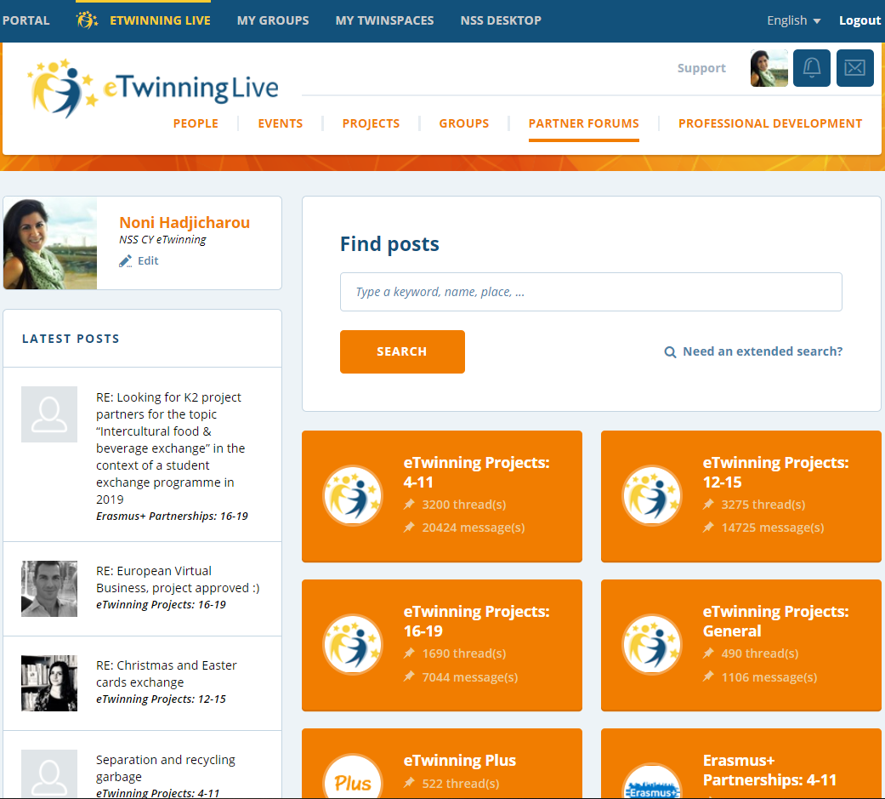
Finding Partners (1/2)
eTwinning
www.etwinning.net

Slide 16
Finding Partners (2/2)
School Education Gateway
www.schooleducationgateway.eu
Three tools and information for schools to prepare their Erasmus+ applications → Strategic Partnerships Tool

Slide 17
Activities Supported by SE Partnerships (1/5)
Virtual Cooperation and Local Project Activities (for example, class-room project work with learners)
Learning, Teaching and Training Activities (LTTs): Activities of exchange of staff and pupils, bringing added value in the achievement of the project’s objectives

Slide 18
Activities Supported by SE Partnerships (2/5)
LTTs for Pupils
Short-term exchanges of groups of pupils:
Duration: 3 days to 2 months
Description: Pupils from countries participating in the partnership work together in activities linked to the aims of the project and can be hosted in each other’s families. Joint project work during the visits takes place in one of the partner schools.
Pupils undertaking this type of activity should
always be accompanied by adults.

Slide 19
Activities Supported by SE Partnerships (3/5)
LTTs for Pupils
Long-term study mobility of pupils:
Duration: 2 to 12 months
Description: Pupils aged at least 14 and enrolled full-time in a school participating in the Strategic Partnership may spend a period in a receiving school and a host family abroad. The two schools are expected to ensure high quality learning outcomes, with appropriate recognition for the involved pupils,
and to constantly support them during their mobility
period.

Slide 20
Activities Supported by SE Partnerships (4/5)
LTTs for Staff
Short-term joint staff training events:
Duration: 3 days to 2 months
Description: Participating organizations in the Strategic Partnership may organize short training events for teaching and non-teaching staff linked to the topic or scope of the Partnership. They can have various formats, i.e. study visits (combining on-site visits to relevant organizations), presentations, discussion workshops, etc. A balance should be kept between the participation of
national and transnational participants.

Slide 21
Activities Supported by SE Partnerships (5/5)
LTTs for Staff
Long-term teaching or training assignments:
Duration: 2 to 12 months
Description: This activity allows teachers and other educational staff, working in a school participating in the Strategic Partnership, to undertake an assignment abroad, by teaching or engaging in professional activities in another partner school. The activity can also take the form of a job-shadowing/an observation period abroad and allows staff to develop
their understanding of European education and training
systems and share methods and practices.

Slide 22
Funding Rules (1/5)
Maximum grant
The maximum grant awarded for a School Exchange Partnership is 16500 per year and per participating school (excluding Special Needs Support and Exceptional costs for expensive travel, for which the grant awarded is based on real costs)
! ! The beneficiaries can use-up the total EU grant received for their project in the most flexible way, throughout its duration and according to their work plan

Slide 23
Funding Rules (2/5)
Budget Headings
Project Management and Implementation
Unit Cost
Exceptional Costs
Real Cost
Learning/
Teaching/Training Activities
Unit Cost
Special Needs Support
Real Cost

Slide 24
Funding Rules (3/5)
Project Management and Implementation
Project Management and Implementation (Maximum=1750 per month)
Eligible Costs:
Project Management (e.g. planning, finances, coordination of partners)
Small Scale Learning/Teaching/Training materials and tools
Website design
Virtual cooperation at local and project activities
Information, Promotion and Dissemination
Hosting Expenses (for example, cultural activities, organized in the context of LTTs)
Contribution
Coordinator: 500 EUR per month
Remaining Partners: 250 EUR per organization per month

Slide 25
Funding Rules (4/5)
Special Needs Support
Special Needs Support
Eligible Costs:
Additional costs directly related to participants with disabilities, provided that the request for these costs is motivated in the application form
100% of Eligible Costs
(on the basis of invoices)

Slide 26
Funding Rules (5/5)
Exceptional Costs
Exceptional Costs
Eligible Costs:
a. Costs related to subcontracting (if the service cannot be directly provided by the partners)
b. Purchase of goods and services (normal office equipment is NOT included)
c. Real costs applied in case of expensive travel costs of participants
75% of Eligible Costs → a. & b.
80% of Eligible Costs → c.
(on the basis of invoices)

Slide 27
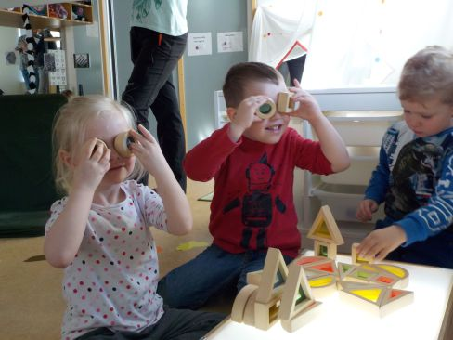
Funding Rules-LTTs (1/5)
Eligible costs
Language, Learning, Training Activities
Eligible Costs:
Travel, Subsistence and Linguistic Support costs related to the realization of LTTs, provided that applicants have justified these activities are necessary to achieve the overall objectives and results of the project

Slide 28
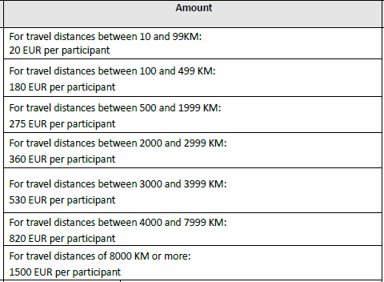
Funding Rules-LTTs (2/5)
Travel
Travel Unit contribution to the travel costs of participants, including accompanying persons, from their place of origin to the venue of the activity and return (even if the activity takes place in their own country)
Distances calculated with the distance calculator

Slide 29
Funding Rules-LTTs (3/5)
Individual Support
Individual Support Unit contribution to costs related to the subsistence of participants, including accompanying persons, during the activity
Days of activity + Travel days (Maximum 2) x applicable rate for the
specific activity type, according to the Program Guide

Slide 30
Funding Rules-LTTs (4/5)
Linguistic Support
Linguistic Support Unit contribution to costs linked to the support offered to participants in order to improve the knowledge of the language of instruction or work
150 Euro per participant needing linguistic support
Note: It applies only for activities lasting between 2 and 12 months

